Slide 1
Predicting Wins from EFG% in College Basketball
Teammate Names: Varun Ganesh
Varun Ganesh, 8/14/2022

Slide 2
Roadmap | Executive Diagram
Teammate Names: John Doe
Data Processing
Model
Evaluation
Test
I cleaned the dataset from Kaggle to my preferred X and Y values. There were originally 10 different variables and I decided to go with EFG%. I then normalized the model.
I decided to use a linear regression model, as this was what was used in the baseline model I was comparing to.
I had an 82% accuracy on my model, which was slightly higher than I expected.
My model performed about 13% worse than the baseline model that I referenced.

Slide 3
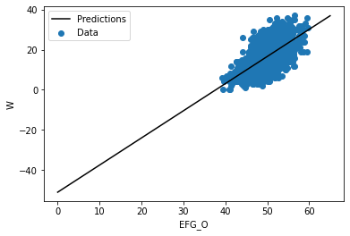
Data Visualization
Teammate Names: John Doe
EFG_O=Effective FG%
W=Wins
I used EFG% as my X variable as it felt the most relevant out of all the given options,.
Wins were my Y variable as that is the ultimate goal of these teams
I then ran my model!

Slide 4
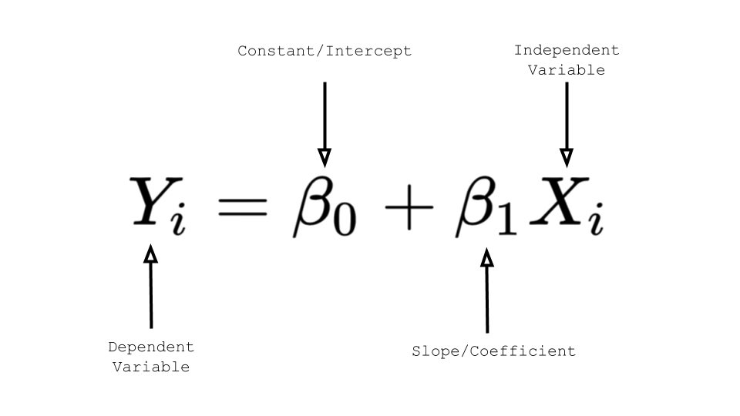
Model Construction
Teammate Names: John Doe
I used a linear regression model for my data.
Y_{i}=Wins
β₀=-46.9
β₁=1
X_{i}=EFG_O

Slide 5
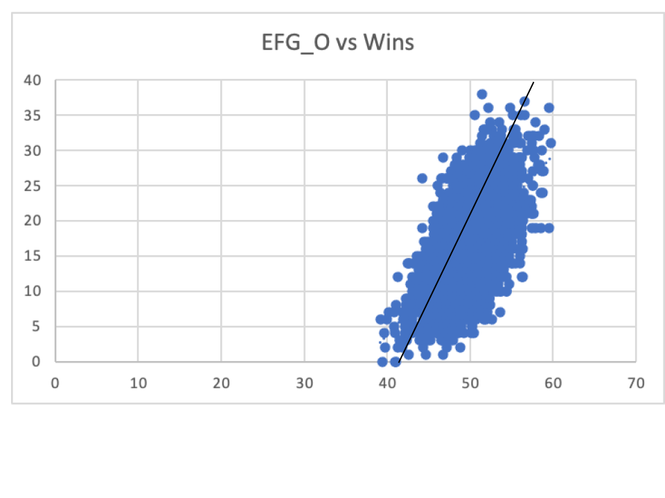
Performance/Comparison to Baseline
Teammate Names: John Doe
LOREM

Slide 6
Conclusions
Teammate Names: John Doe
My model had a 82% accuracy when calculating the wins from EFG_O. I was hoping to have slightly better accuracy.
This is 13% lower than the baseline model, which was a linear regression model.
I learned how much work goes into making even the simplest models.

Slide 7
Thank You

